Slide 2
Aim
To discuss our similarities and differences.
To understand the term ‘discrimination’.
To understand the term ‘diversity’.
Success Criteria
I will be able to identify ways in which we are different and the same.
I will recognise when someone is being discriminated against.
I will respect that society is made up of a diverse range of people that have different attitudes, opinions and beliefs.
I will know ways to ensure people are included.

Slide 3
Embrace Our Differences
Within society, people don’t always get along and sometimes people forget that it is other people’s differences that make them unique and special.

Slide 4
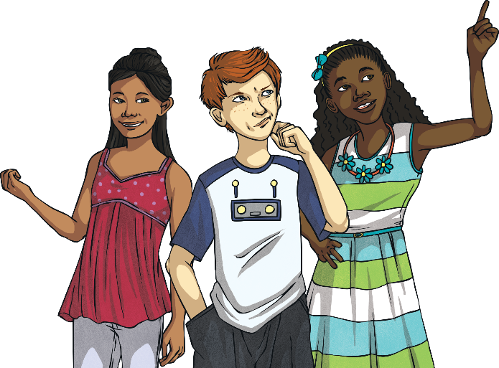
What Things Make Us Unique?
No two people are exactly the same. Discuss with a partner all the things that make us unique.
height
skin colour
type of family
eye colour
gender
hair colour
sexuality
what else?
disability

Slide 5
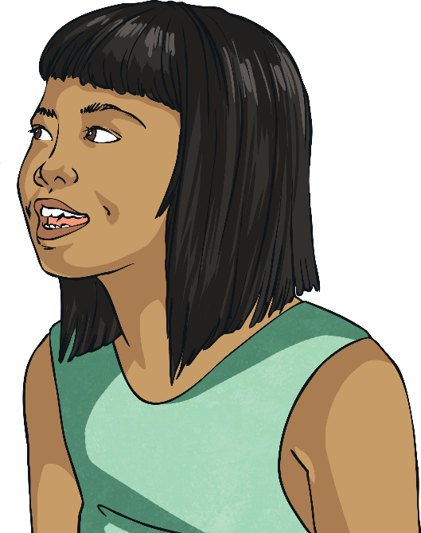
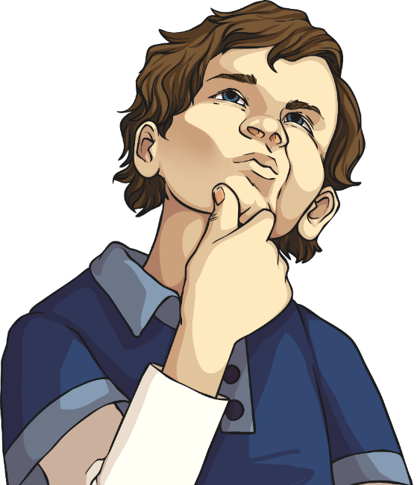
What If We Were All the Same?
Discuss with your partner what you think life would be like if everyone looked and acted in exactly the same way.

Slide 6
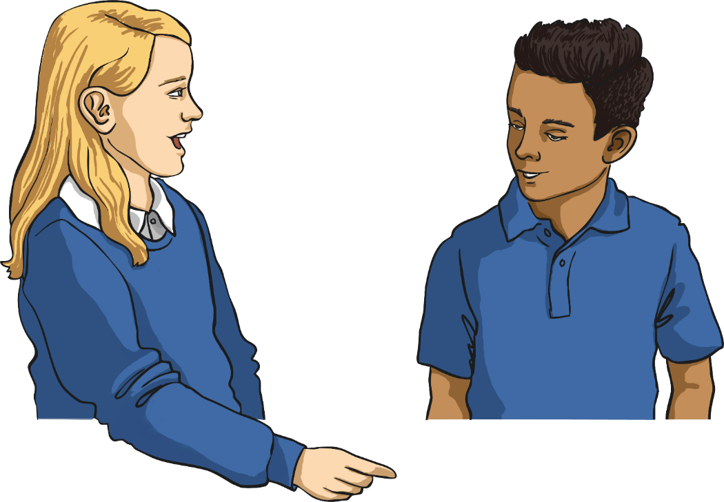
What Things Make Us Special?
Tell your partner one thing that you think is special about them. It might be their hair, their smile, their kindness or a unique talent.

Slide 7
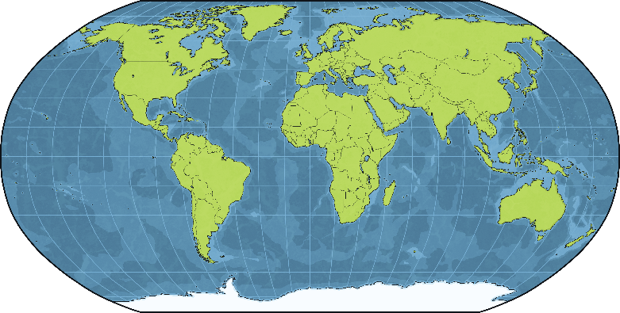
Differences in Heritage
Lots of people originally came from different countries to the country they live in now, or their ancestors did. This can often mean that new ideas, beliefs and customs are shared. This diversity makes life more interesting.
Look at this map of the world and try to spot as many countries as you can. In pairs, research a country of your choice and find five interesting things about the customs and traditions there that you find interesting and different.
ancestors - Your relatives from history.
customs - Something that many people do, or have done, for a long time.
diversity - Differences.

Slide 8
Discrimination
When a person doesn’t respect the different qualities and opinions of another person or group, this can often be called discrimination.
Discrimination is the unfair treatment, or bullying, of one particular person or group of people. Often, this unfair treatment is because of the beliefs, race, gender, disability or sexual orientation of that person or group.

Slide 9
How Might People Discriminate Against Others within School?
Discuss with your partner, or within a group, how people may show their discrimination within school.
People might:
deliberately leave someone out of a game or group;
say something mean about another person’s skin colour, religion, disability or another part of their identity;
tell another person that their personal beliefs and opinions are wrong;
discuss a person’s personal beliefs and opinions in an unkind way.

Slide 10
Dealing with Discrimination
If you thought you were being bullied or discriminated against, what do you think you should do?
If you heard someone being unkind at school, who would you tell?
What would you do?
If you heard someone being unkind at home, who would you tell?
What would you do?

Slide 11
Reflection
What did you find out today that you didn’t know before?
If someone looks, acts, behaves or sounds differently to you, appreciate their differences! Diversity is a positive thing to have within society.
We are all different.
We all have the right to our own opinions and beliefs and that is what makes our school, and our world, a special place.

