Slide 2
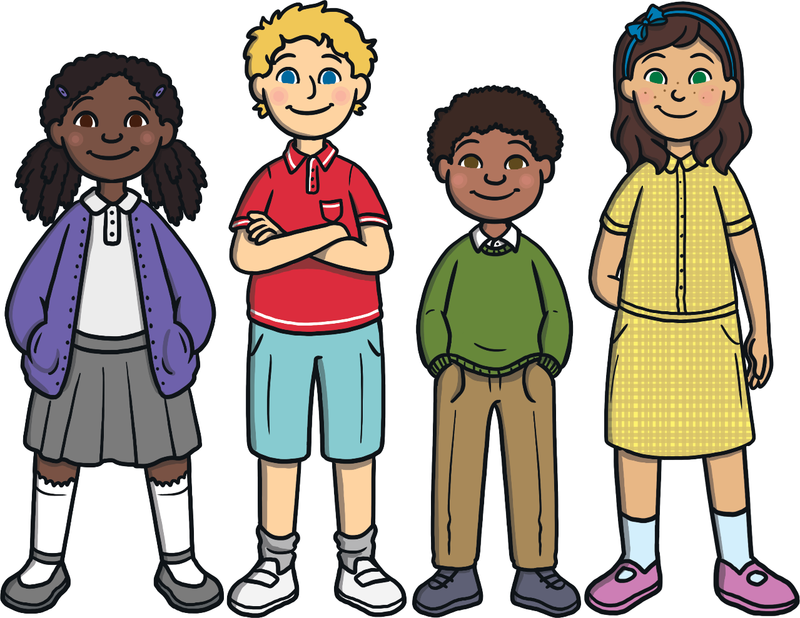
What Things Make Us Different?
No two people are ever the same! Look around your classroom. Think about the different people that you know. What makes you different from each other?
eye color
hair color
height
skin
color
type of family
What else?

Slide 3
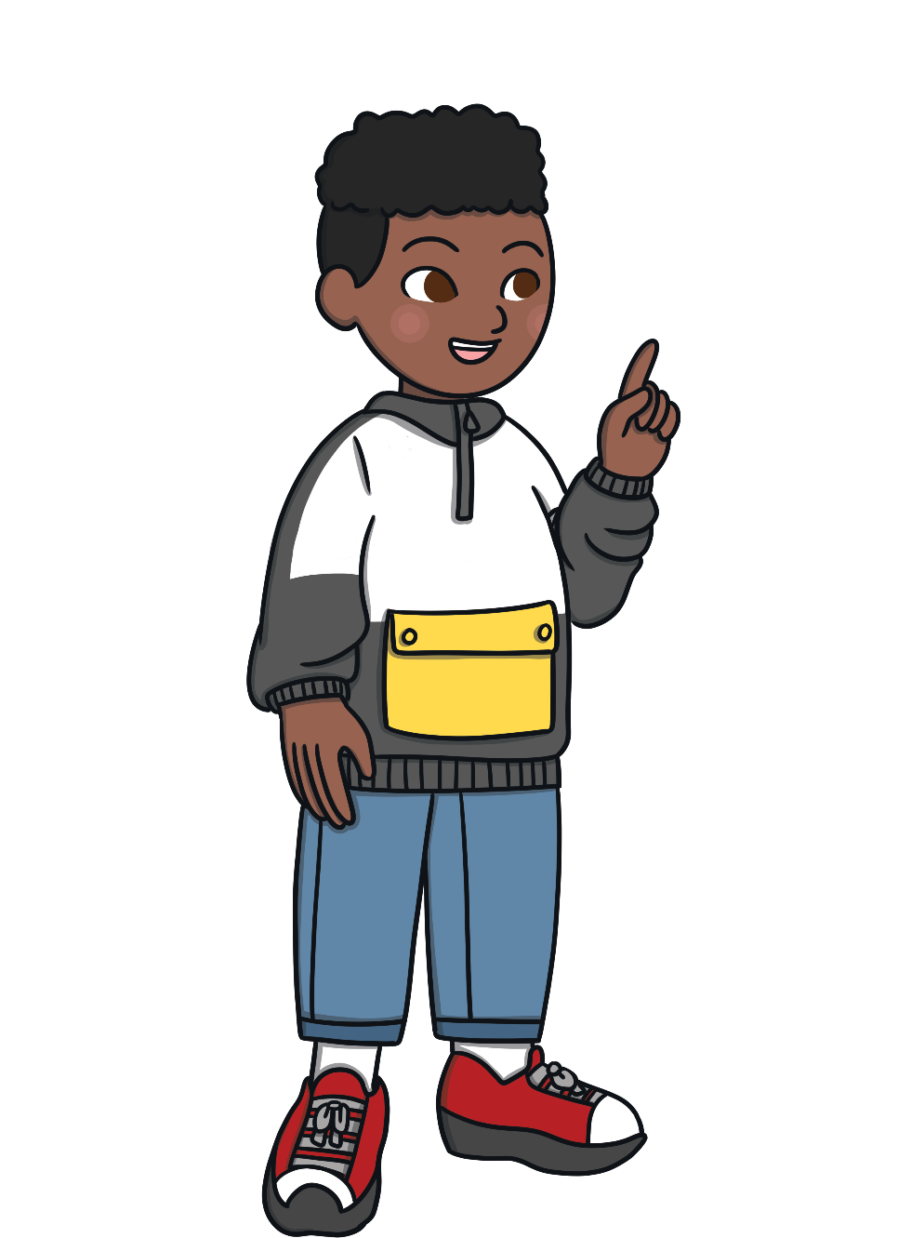
What Things Make Us Special?
Tell your partner one thing about them that is special. It might be the color of their hair or something that you know they like
or are really good at.

Slide 4
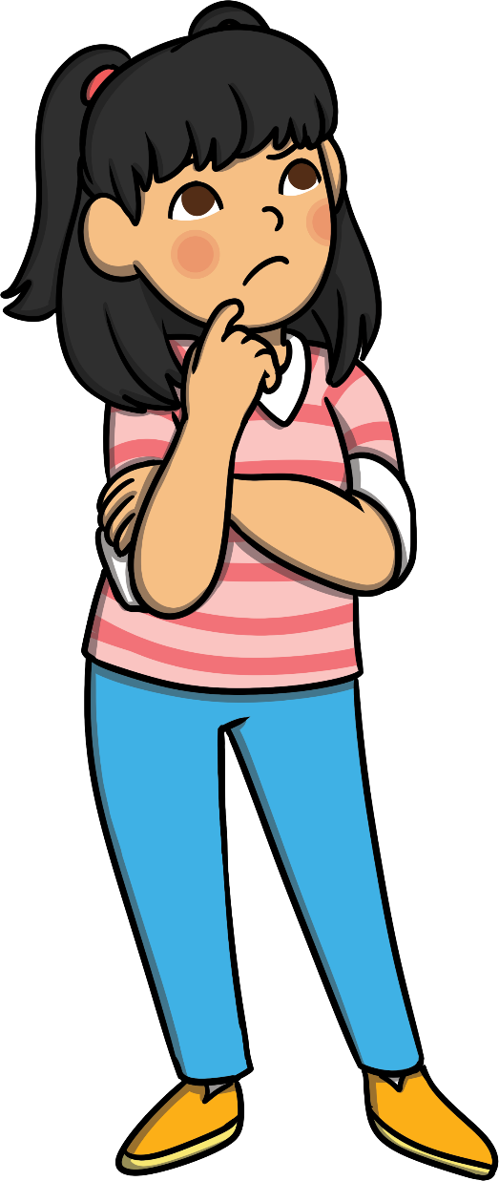
What If We Were All the Same?
Just imagine if everyone looked the same,
and we all liked the same things.
Would life be as fun if we all looked the same
and thought the same things? No, it would not!
Talk to your partner about what you think life would be like if everyone looked the same and if everyone was good at the same things.

Slide 5
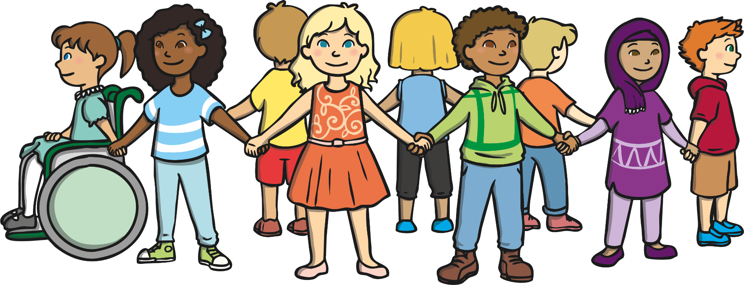
Why Are People Different?
Many people in this country have come from other countries, or their families came from other countries. This is a great thing because it means we have a mix of different people and cultures living together.
Different people and cultures living together is called diversity.

Slide 6
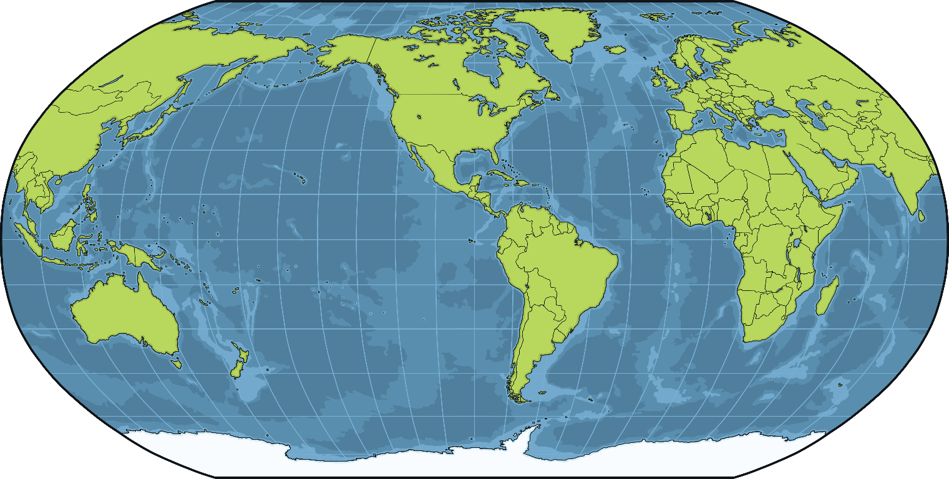
Why Are People Different?
Look at this map of the world.
Did you or anyone in your family come from a different country?
Do you have any family or friends who live in another country?

Slide 7
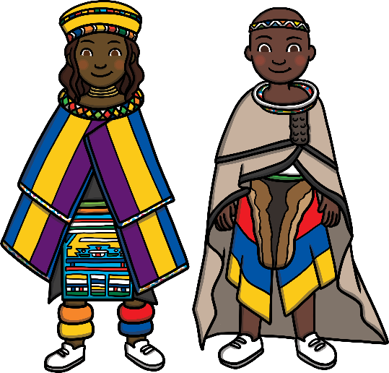
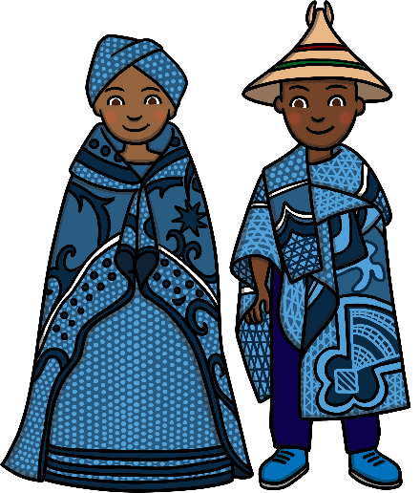
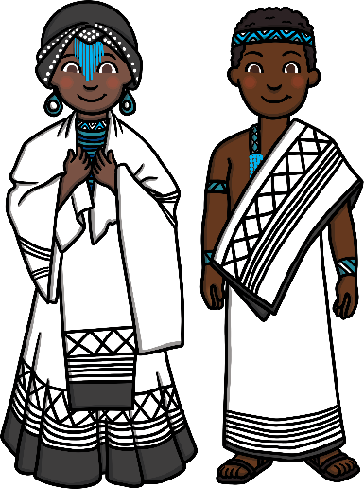
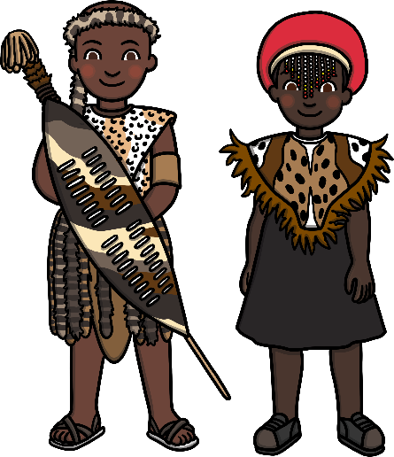
Respecting Differences
It is very important to respect people’s differences and to be kind
to each other. We can learn so many new things from others that
are different from us. Being different is what makes us all
special and interesting!
Being unkind and disrespectful about the ways someone is different
is called discrimination.

Slide 8
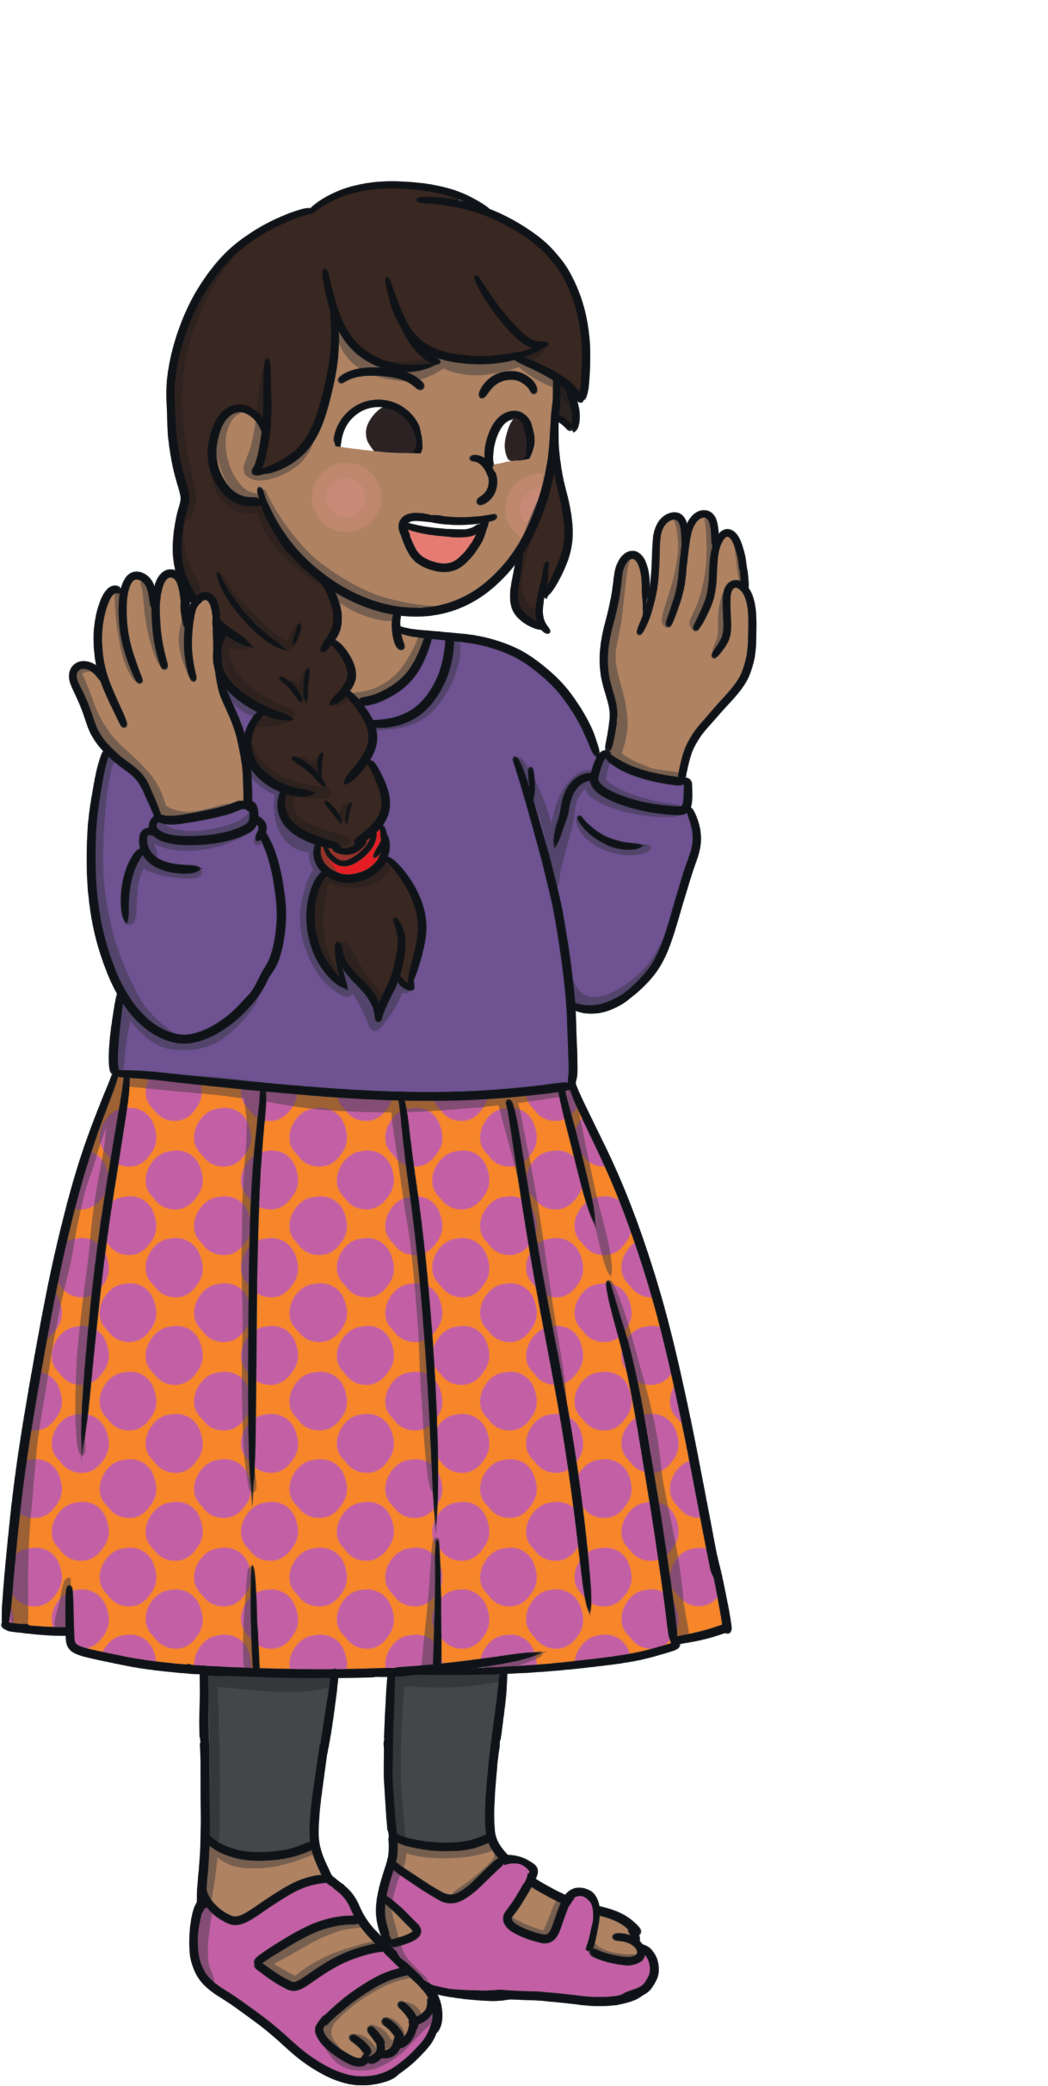
Let’s talk about it...
Why is discrimination harmful to others?
Why is not okay to discriminate against others?

Slide 9
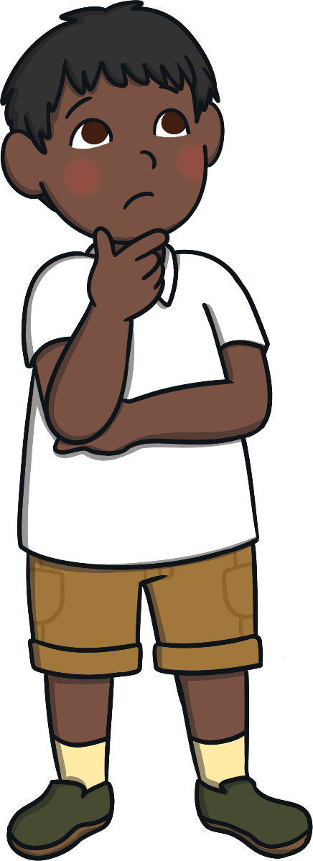
What to Do If Discrimination Is Happening
If you thought you were being bullied because of your
differences, what do you think you should do?
If you heard someone being unkind about differences at
school, who would you tell? What would you do?
If you heard someone being unkind about differences at
home, who would you tell? What would you do?

Slide 10
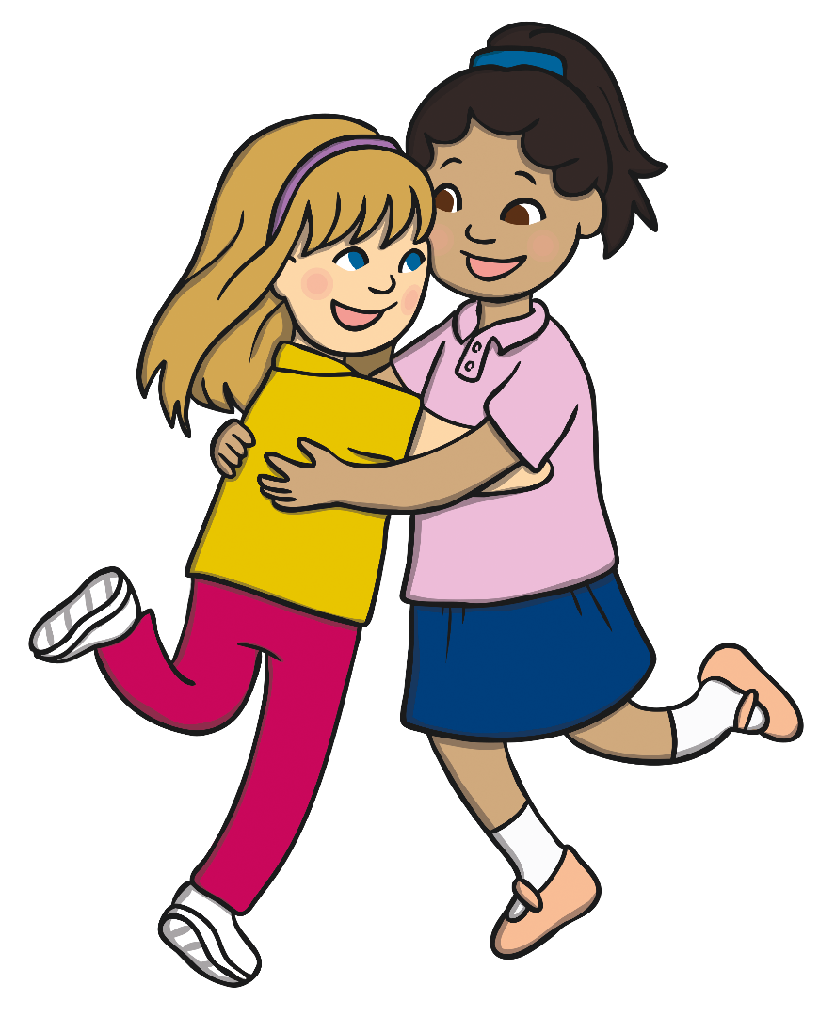
Reflection
What did you learn today that you didn’t know before?
If someone looks, acts, or sounds different than you, it is a good thing. We need to celebrate our differences!
Differences are what make us all special.
We all have the right to our own thoughts and beliefs. This is what makes our school and our world a special place.

