Slide 1
Disclaimer/s
We hope you find the information on our website and resources useful.
Animations
This resource has been designed with animations to make it as fun and engaging as possible. To view the content in the correct formatting, please view the PowerPoint in ‘slide show mode’. This takes you from desktop to presentation mode. If you view the slides out of ‘slide show mode’, you may find that some of the text and images overlap each other and/or are difficult to read.
To enter slide show mode, go to the slide show menu tab and select either from beginning or from current slide.
You may wish to delete this slide before beginning the presentation.

Slide 3
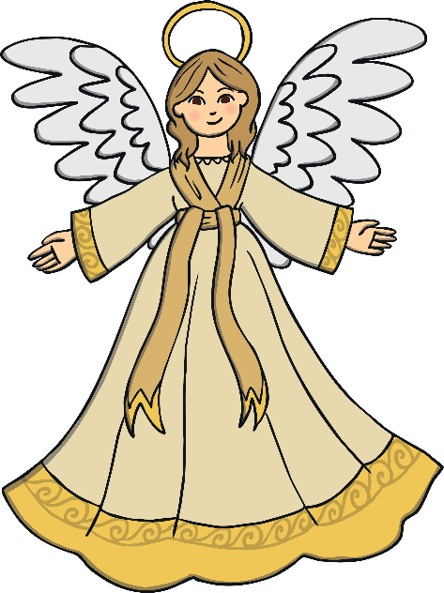
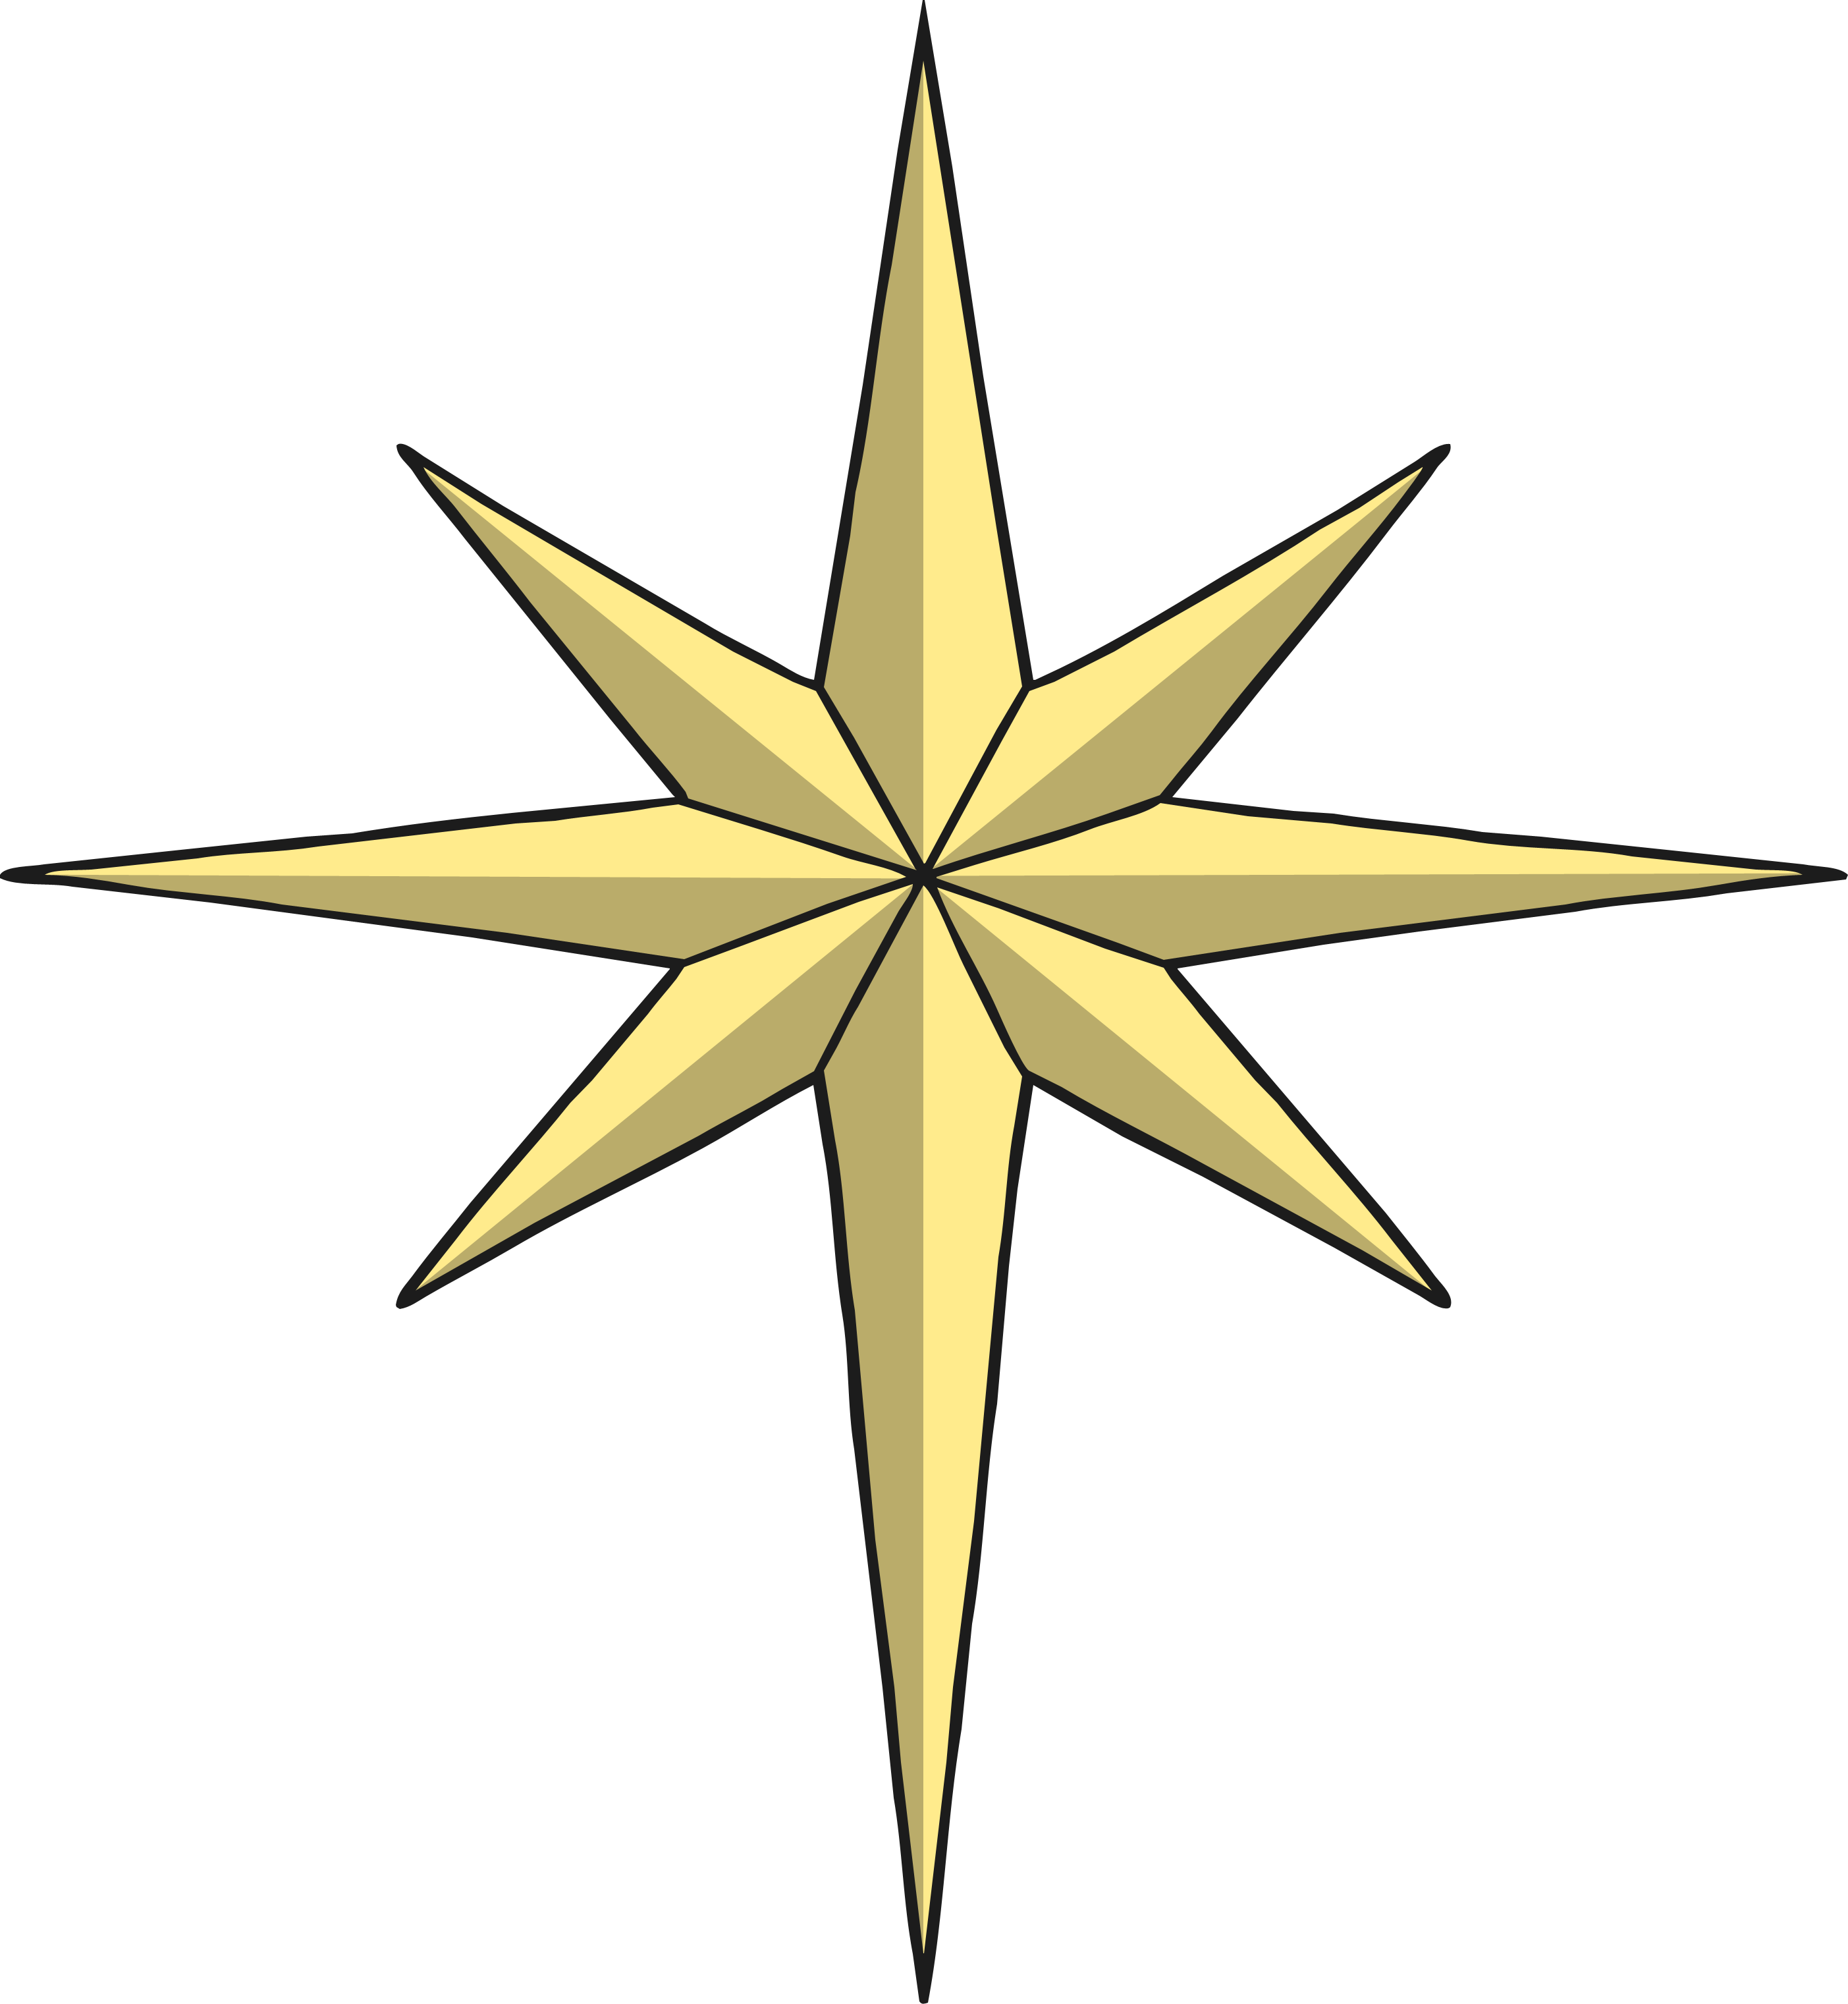
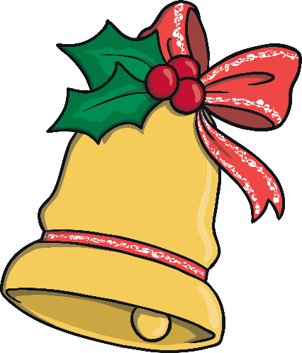
What is a Symbol?
A symbol is an object with a special meaning. These are often used at different religious events and festivals.
Some objects represent something important.

Slide 4
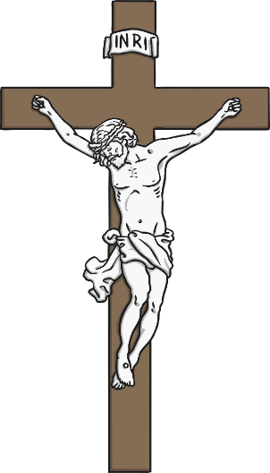
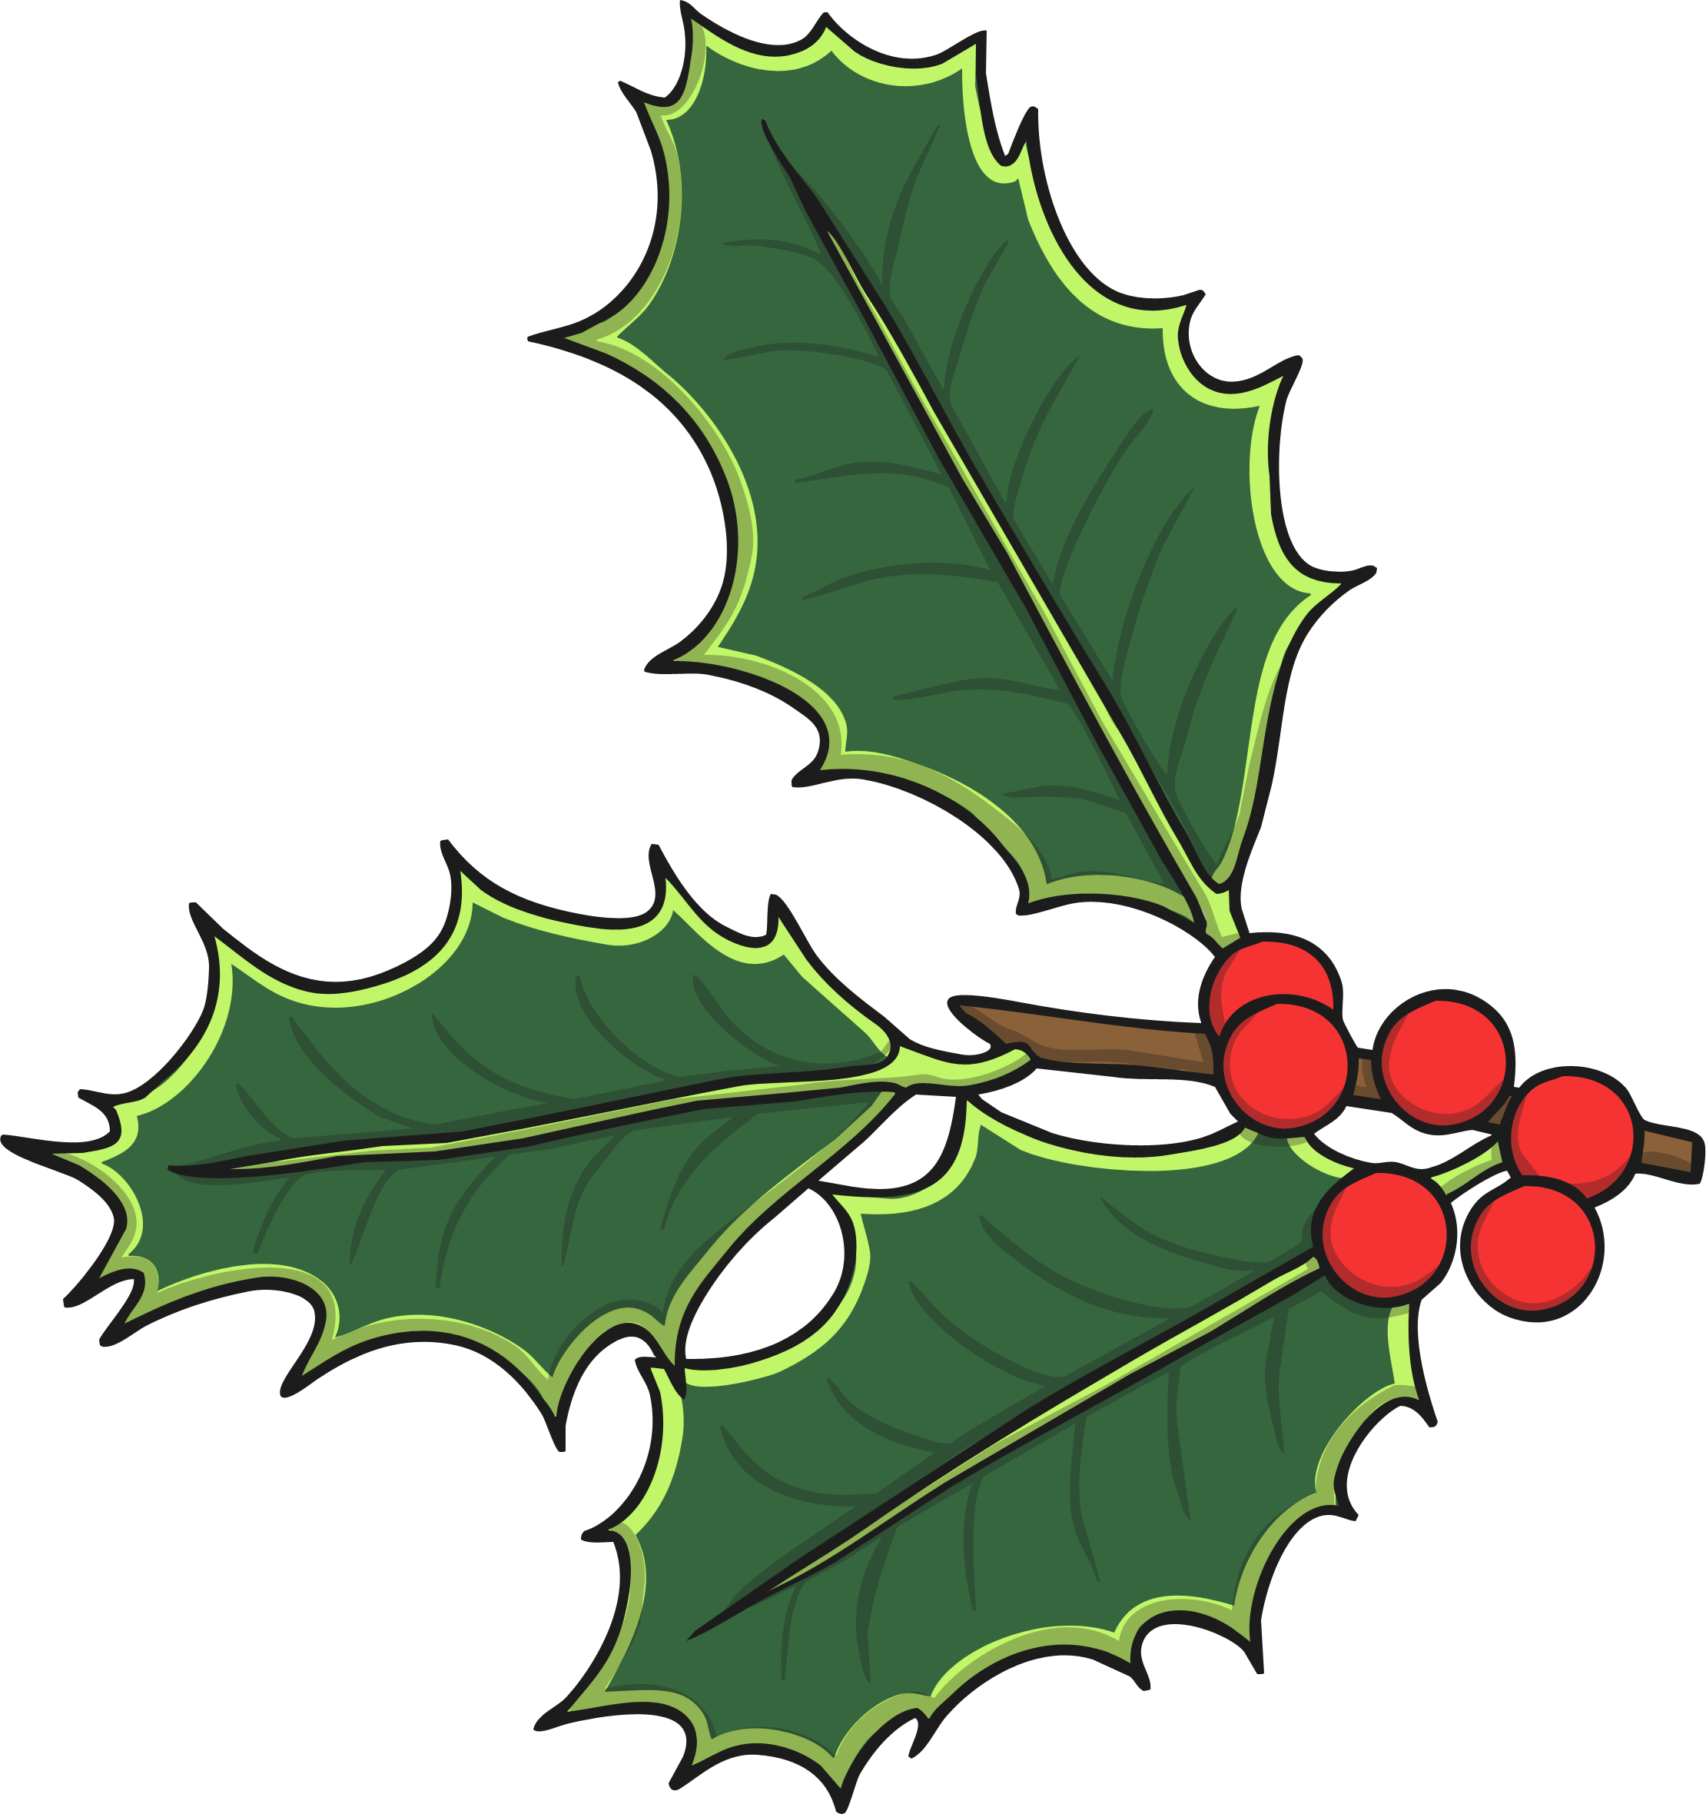
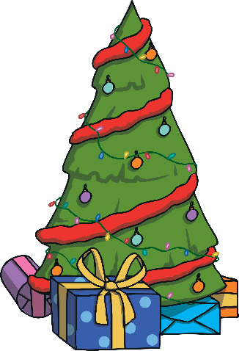
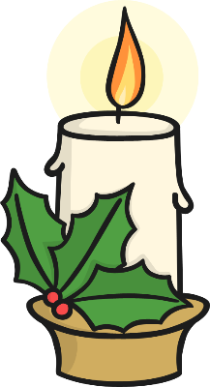
Christmas Symbols
Christmas is a time when a lot of things have special meaning.
Many have religious meanings.
Some of the meanings come from Paganism and some come from Christianity.
Click on each symbol to find out its meaning.

Slide 5
Holly
Holly is symbolic of the crown of thorns Jesus wore when he was on the cross at Easter.
Holly has been used by Pagans to keep bad spirits away.

Slide 6
Fir Trees
Fir trees are evergreen. This means they stay green all year round and the leaves, or needles, don’t fall off.
Christians believe it is a symbol of God’s everlasting love.
Pagans would cut branches off evergreen trees and bushes, bring them into their homes and decorate them with ornaments in worship to their gods.

Slide 7
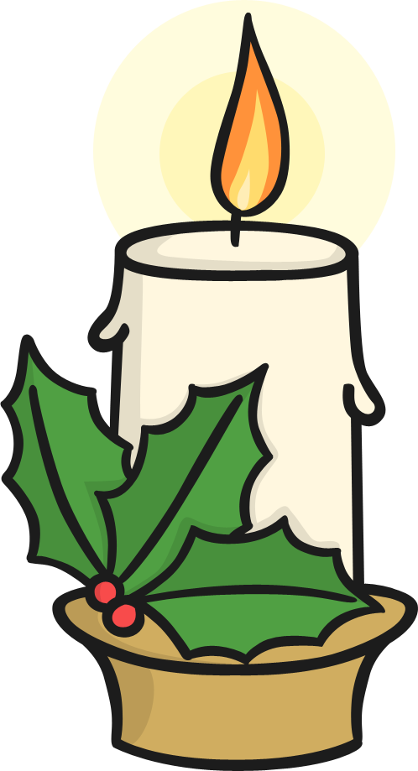
Candles
Candles represent Jesus who is often called the Light of the World.
Pagans used candles to bring heat and light during the dark winter months. They have also been used to represent welcoming the spring.

