Slide 2
What do you already know about the Antarctic?

Slide 3
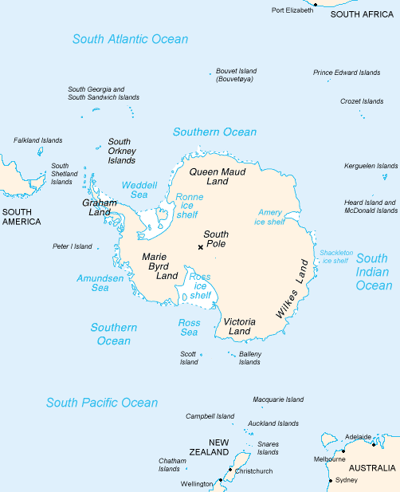
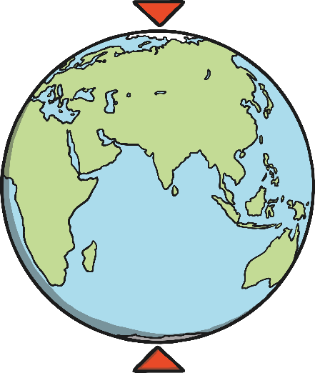
Polar Region
The Antarctic is a polar region, around the South Pole.
It is opposite the Arctic region, which is around the North Pole on the other side of the earth.
North Pole
South Pole

Slide 4
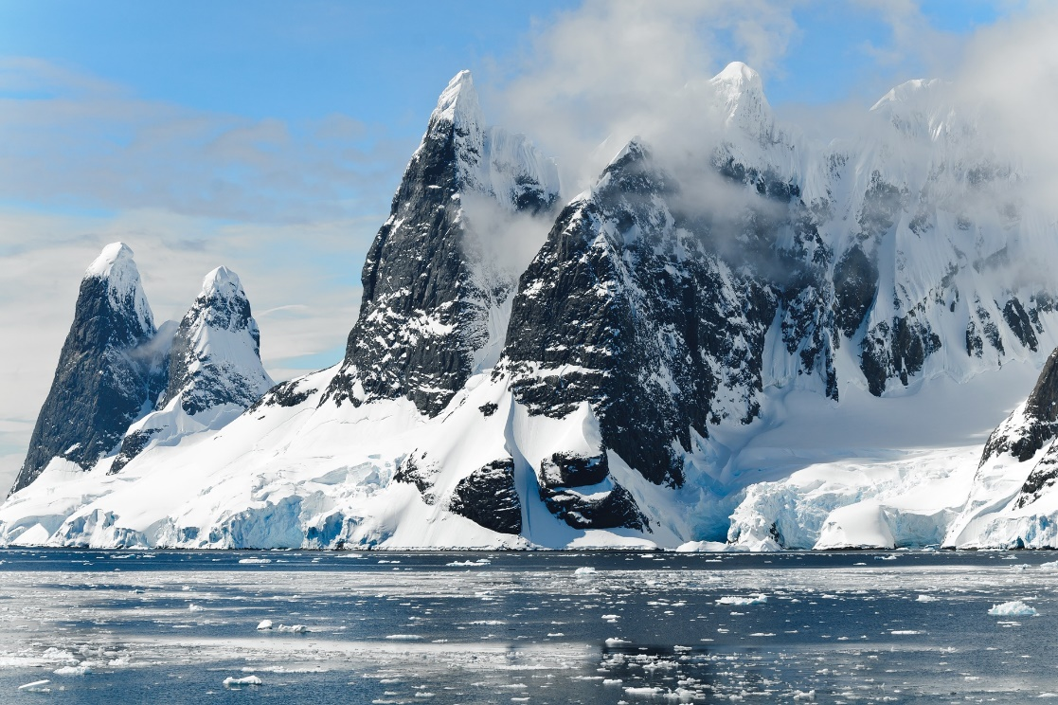
Antarctic Region
The Antarctic covers the continent of Antarctica and some ice shelves and islands in the Southern Ocean.
These islands include Scott Island, the South Orkney Islands, Balleny Islands, South Shetland Islands and many more!

Slide 5
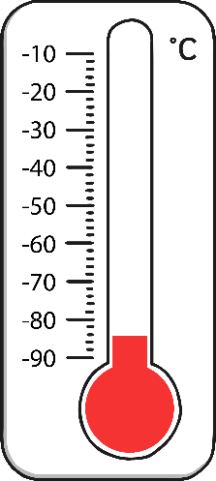
Antarctic Region
Most of the land is covered all the time by snow and ice.
Only 1% of the land is showing!
There are icebergs in the Southern Ocean.
Icebergs are pieces of ice which have broken off and are floating in the ocean.
Antarctica is the coldest continent on earth!
The world’s coldest temperature
ever recorded was in the Antarctic.
It reached -89.2°C in 1983!

Slide 6
Can you think of any animals that live in the Antarctic?

Slide 7
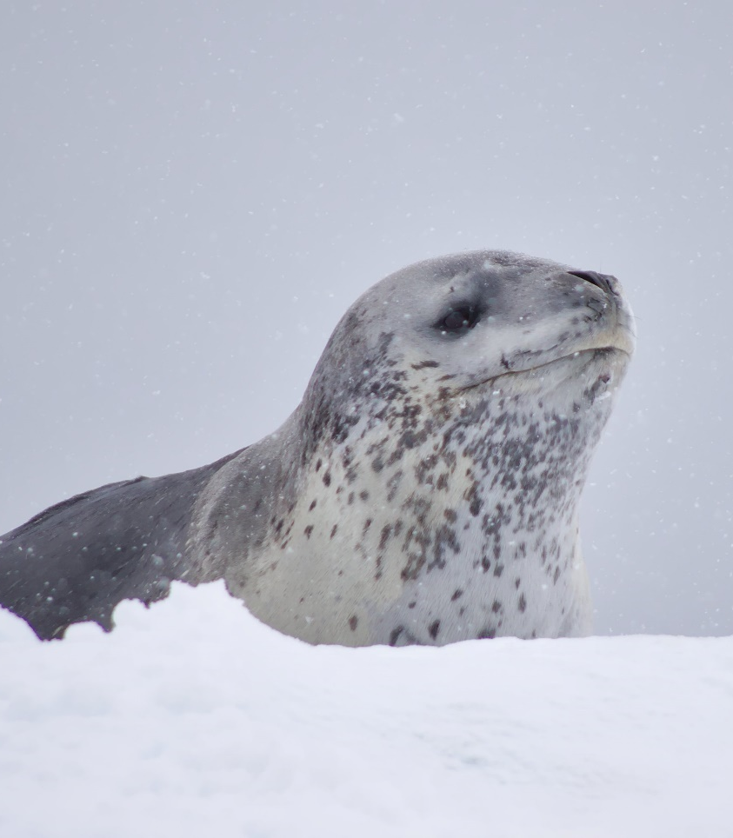
Antarctic Animals
emperor penguin
seal

Slide 8
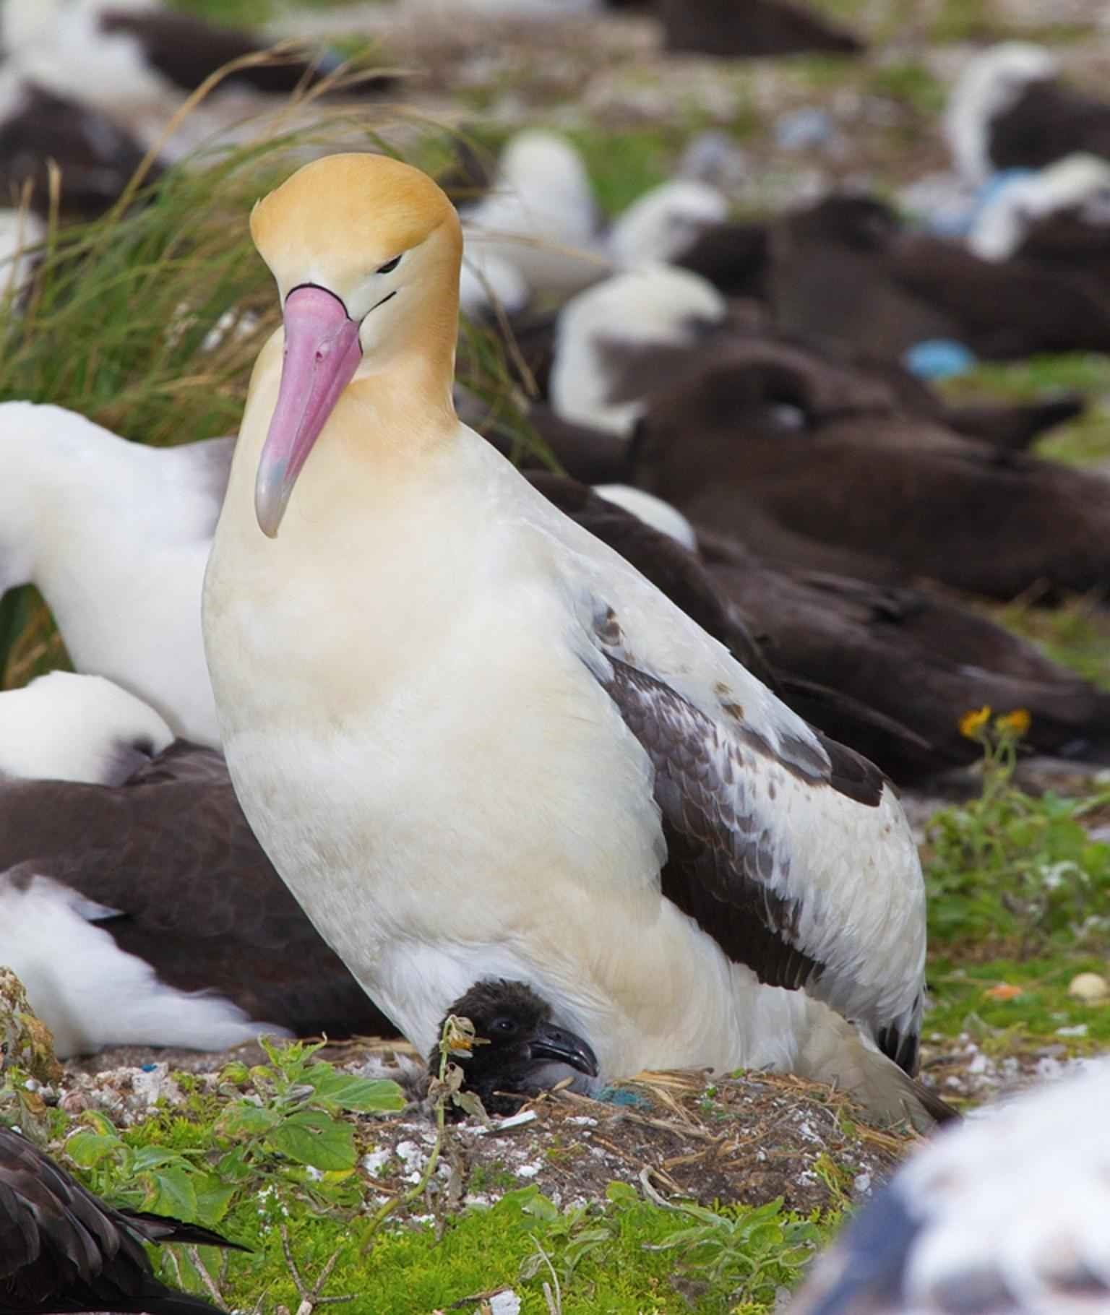
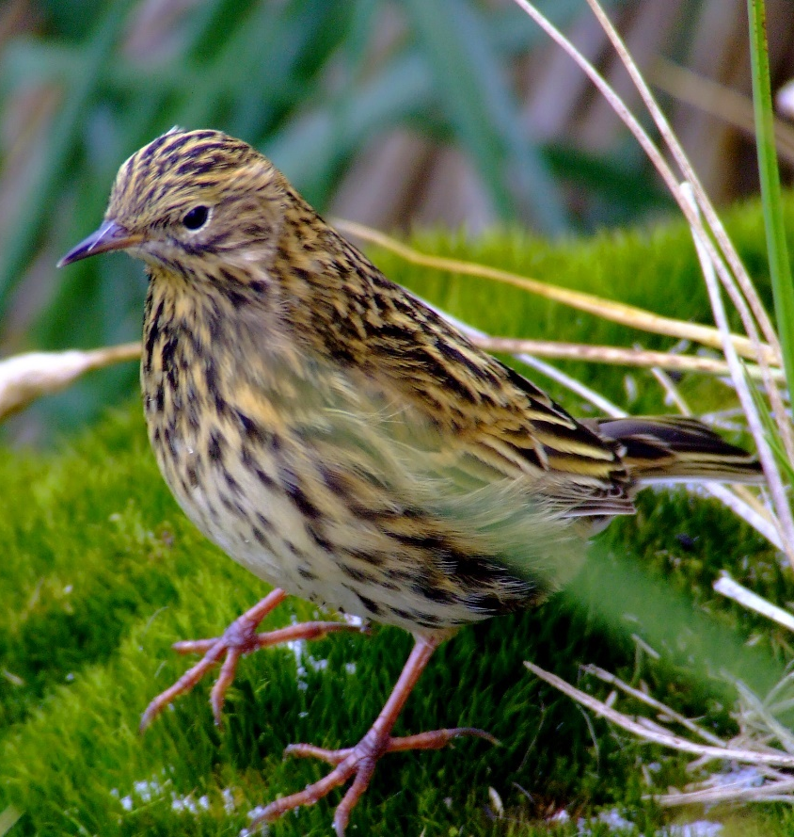
Antarctic Animals
albatross
South Georgia pipit

Slide 9
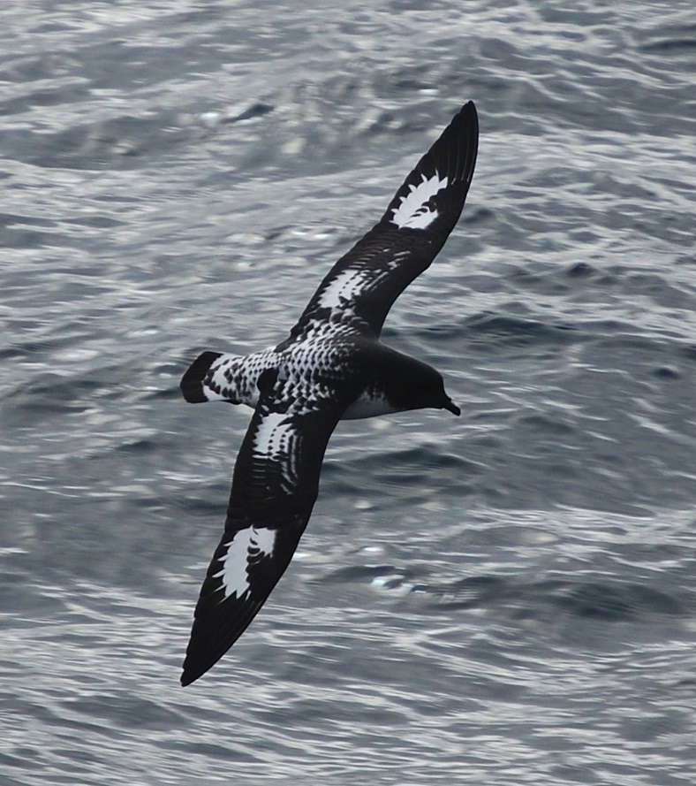
Antarctic Animals
Antarctic petrel
orca (killer whale)
Photo courtesy of kenaifjordsnps(@flickr.com) - granted under creative commons licence – attribution

Slide 10
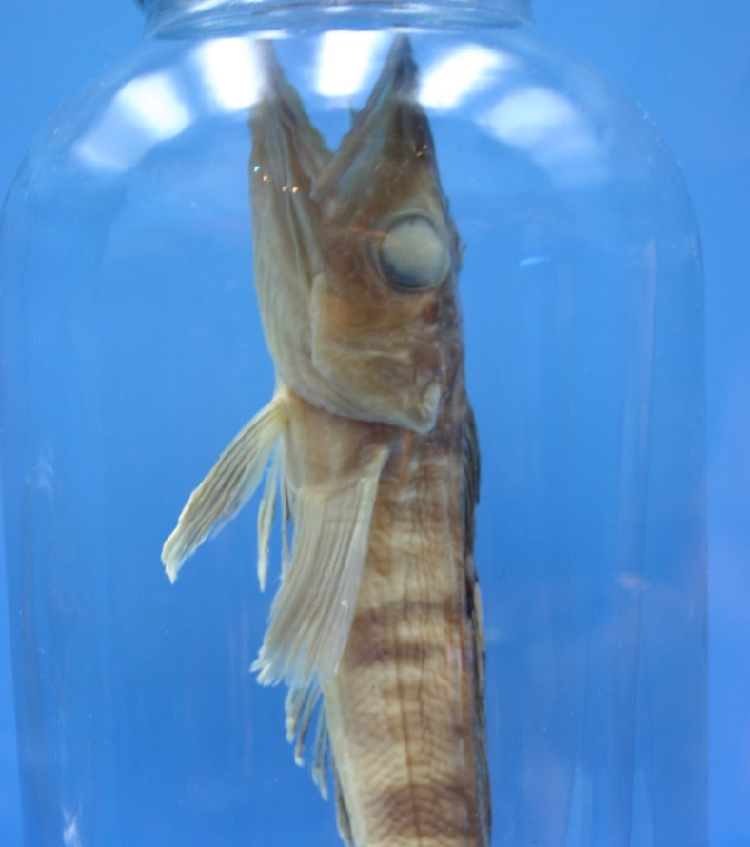
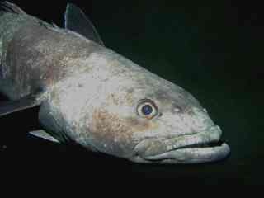
Antarctic Animals
Antarctic icefish
Antarctic toothfish
Photo courtesy of ideonexus, Pcziko (@wikimediacommons.com) - granted under creative commons licence – attribution

Slide 11
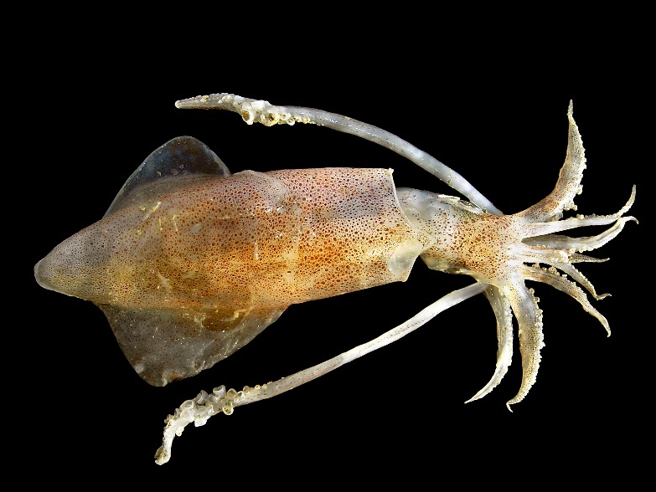
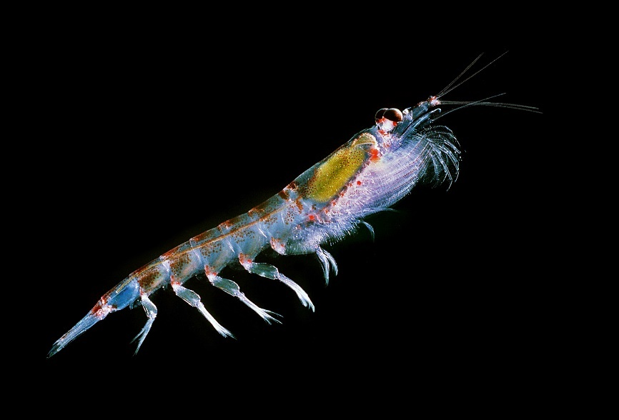
Antarctic Animals
squid
Antarctic krill
Photo courtesy of Hans Hillewaert, By Krill666 (@wikimediacommons.com) - granted under creative commons licence – attribution

Slide 12
Land Animals
Belgica antarctica
(a midge without wings only 1.3cm long)
Did you know…?
Antarctica is the only continent in the world with no native species of ant.

Slide 13
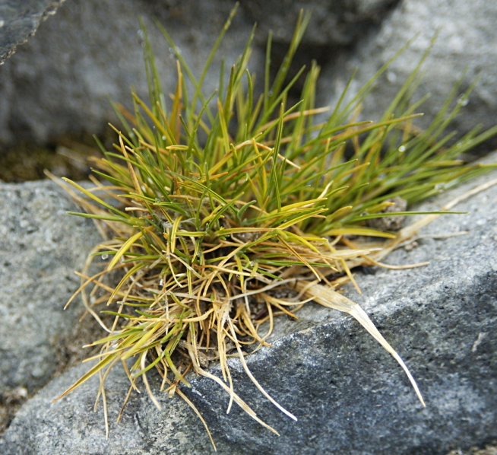
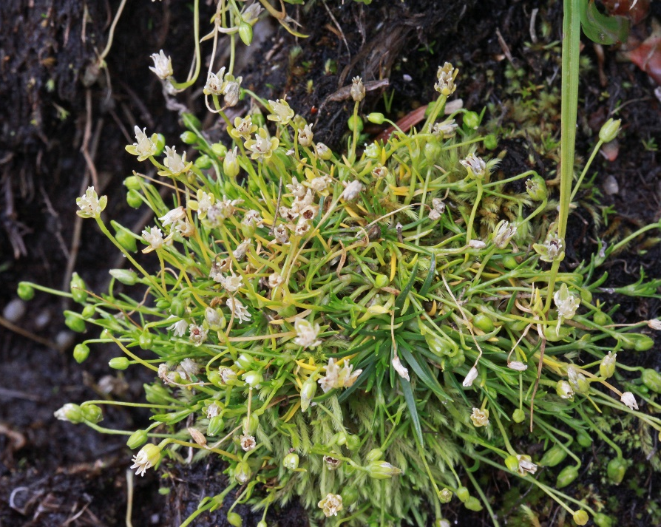
What Grows in the Antarctic?
There are two types of flowering plant:
Antarctic hair grass
Antarctic pearlwort
There are also types of lichens, mosses, macrofungi and liverworts.
Photo courtesy of Lomvi2 (@wikimediacommons.com) and zharkikh (@flikr.com)- granted under creative commons licence – attribution

Slide 14
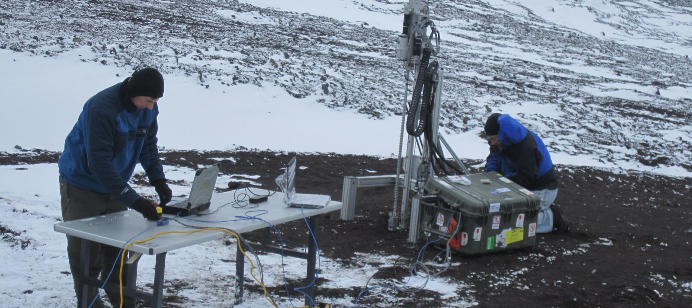
Do People Live in the Antarctic?
No one has their permanent home in the Antarctic.
Only scientists and other people working at research stations stay there.
There are icebergs in the Southern Ocean.
Icebergs are pieces of ice which have broken off and are floating in the ocean.
Photo courtesy of Lomvi2 (@wikimediacommons.com) and zharkikh (@flikr.com)- granted under creative commons licence – attribution

Slide 15
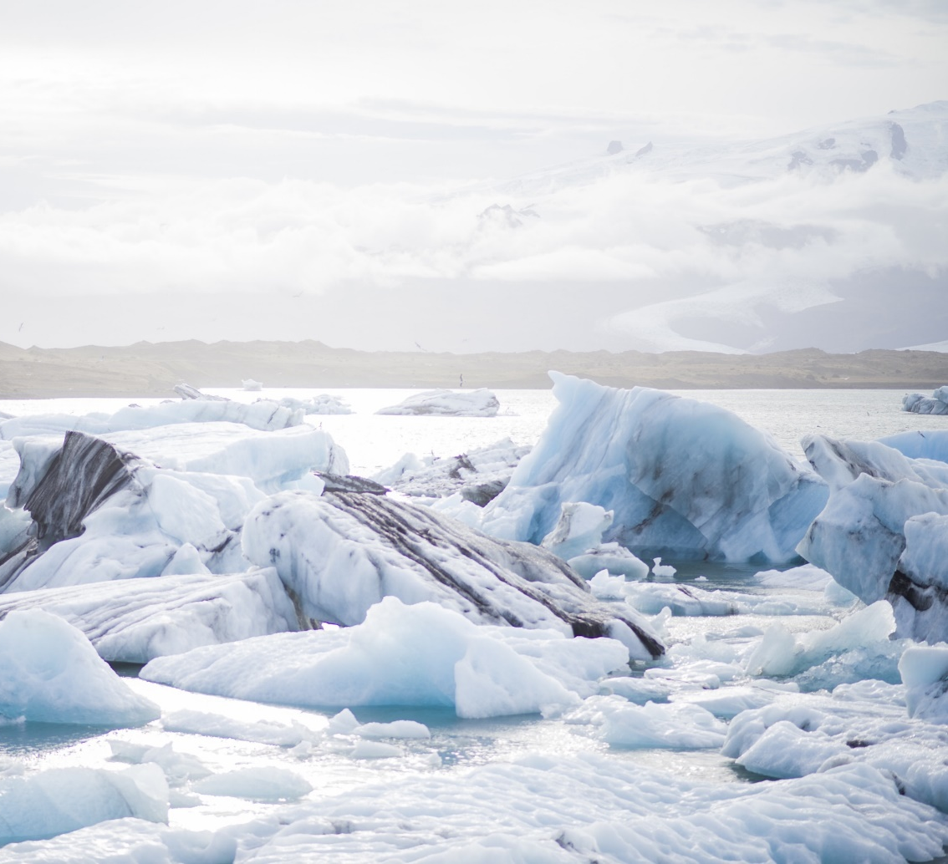
What Do Scientists Do There?
Scientists work in Antarctica to discover new things, measure and test the ice, monitor the effects of global warming, research light, study animals and lots more.

Slide 16
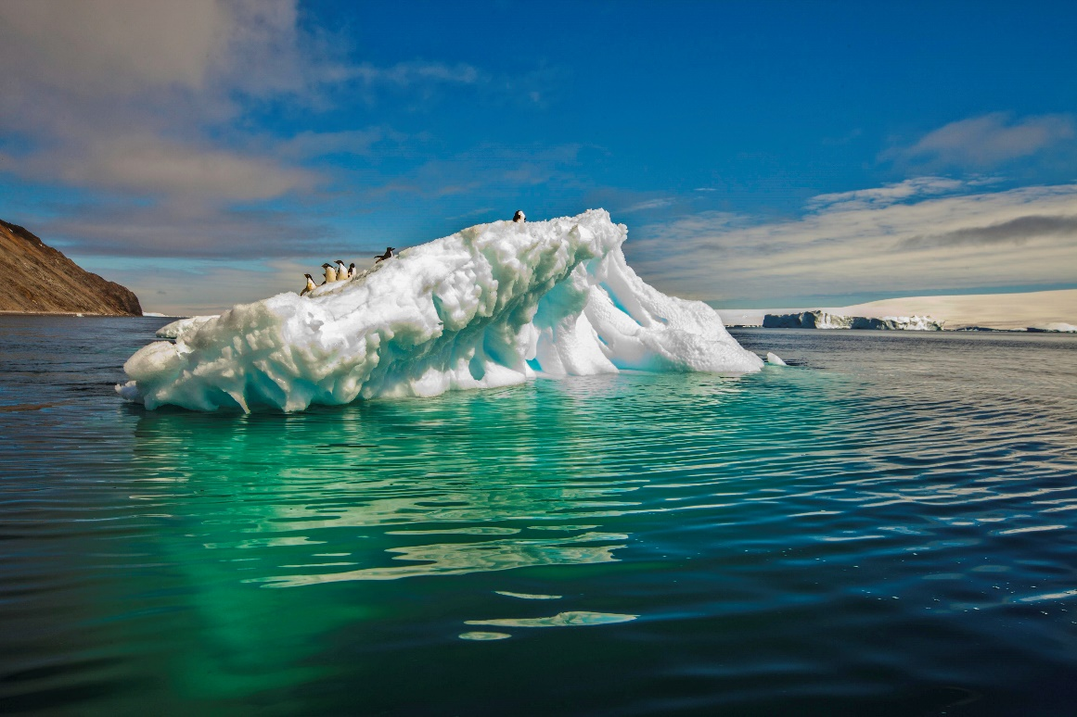
Would you like to visit the Antarctic?

